Slide 1




A ROOF OVER THEIR HEADS
A CASE STUDY ON CANADIAN HOUSING MARKET

Slide 2


GROUP 9
Malay Vagadiya 100943103
Rahul Sonal 100949401
Sahil Verma 100948130
Ahsan Mohammed 100899727
Elton Ferreira 100902266
Suhaib Baleegh 100897200
Manan Sethi 100947454

Slide 3
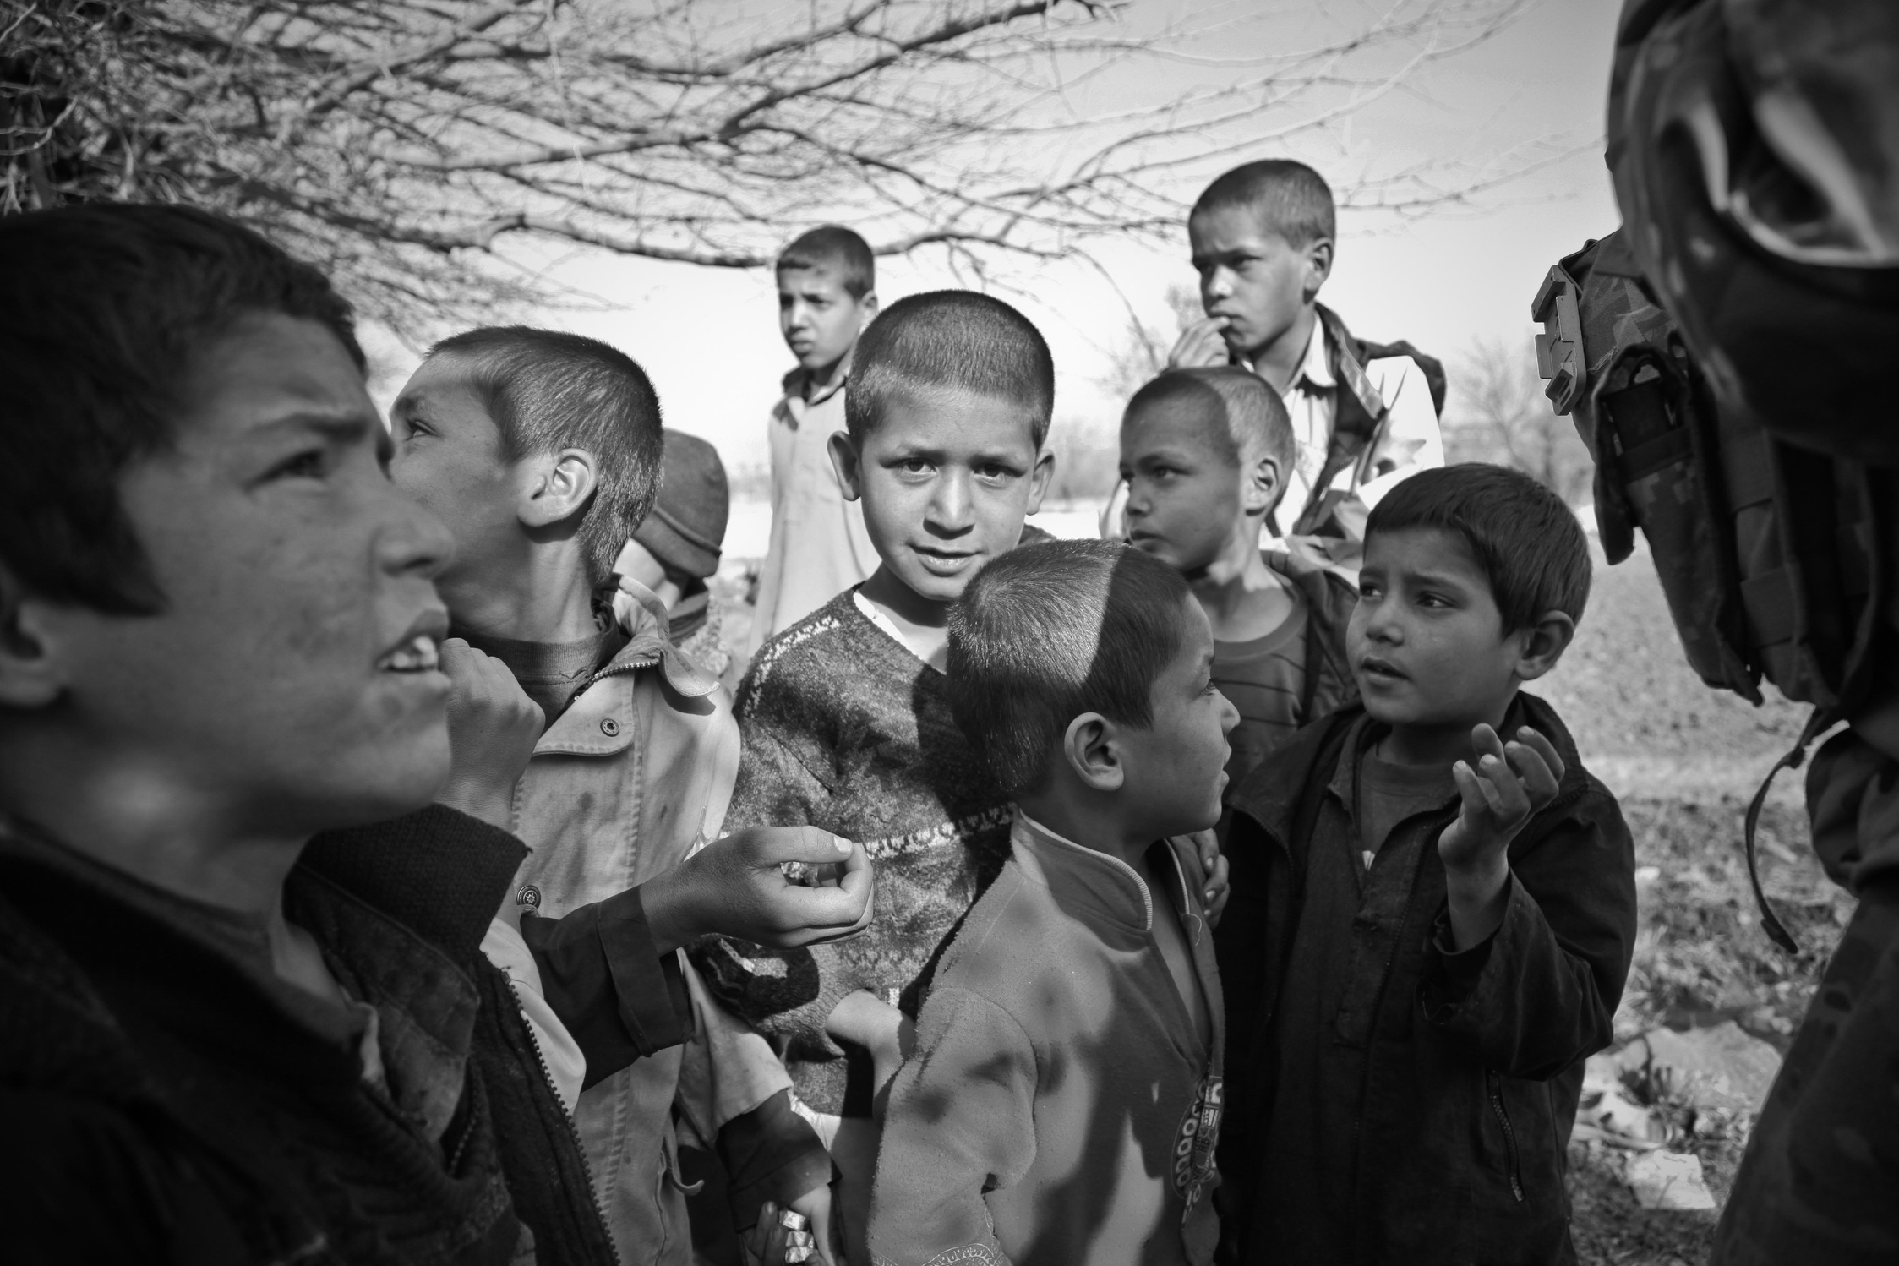



INTRODUCTION
The Russian Invasion of 2022 displaced millions of Ukrainians.
Many moved to countries like Canada as refugees. .
Among those seeking a new beginning is the Kowalski family.
Yuriy and Anastasia, must put aside their trauma to begin a new chapter in their lives.

Slide 4




THE NEWCOMERS
The Parents Oleksiy and Oksana face uncertainty for the future of their kids Yuriy and Anastasia
Upon arrival, they are confronted with the challenging housing landscape in Canada.
The Begin to research their future and how to build a new home in canada

Slide 5

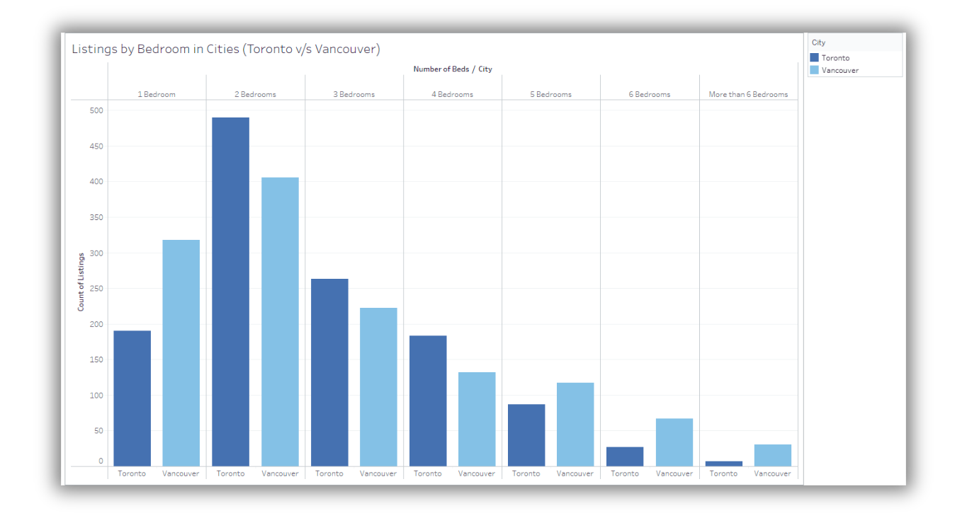
Toronto Or Vancouver?
Initially, bound by community and lack of knowledge they wanted to look for a home within established communities and cultural hubs

Slide 6
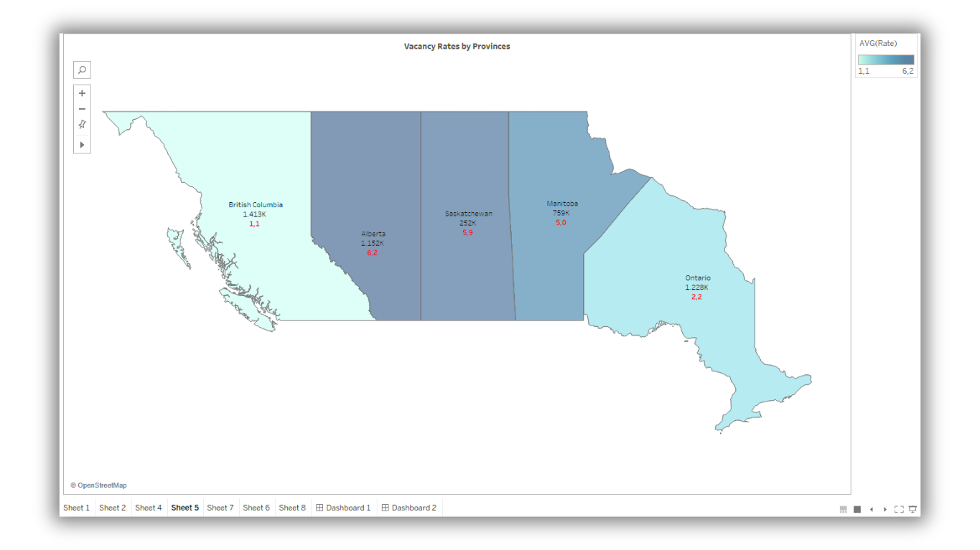

A bigger Picture : Vacancy Rates
High prices, high competition and Low vacacny rates open their eyes to a bigger Canada than just two cities.

Slide 7

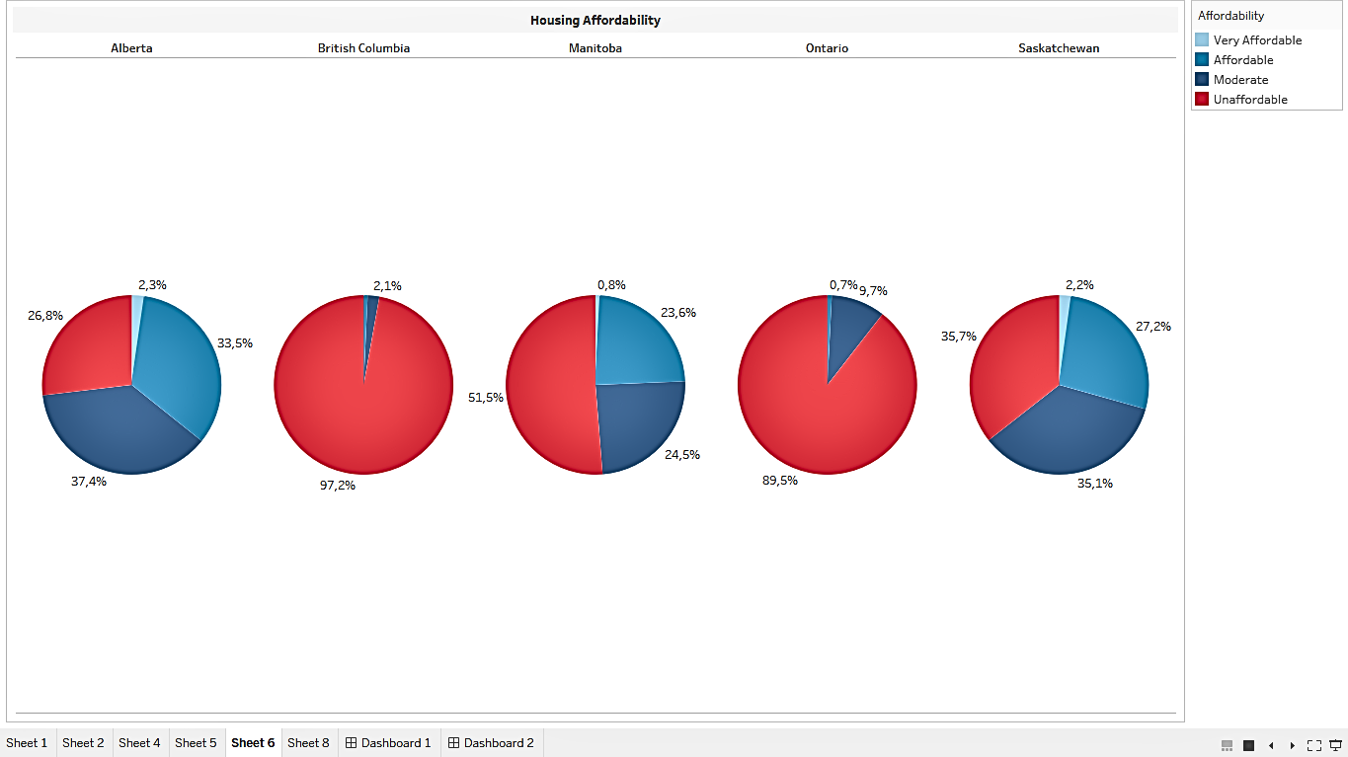
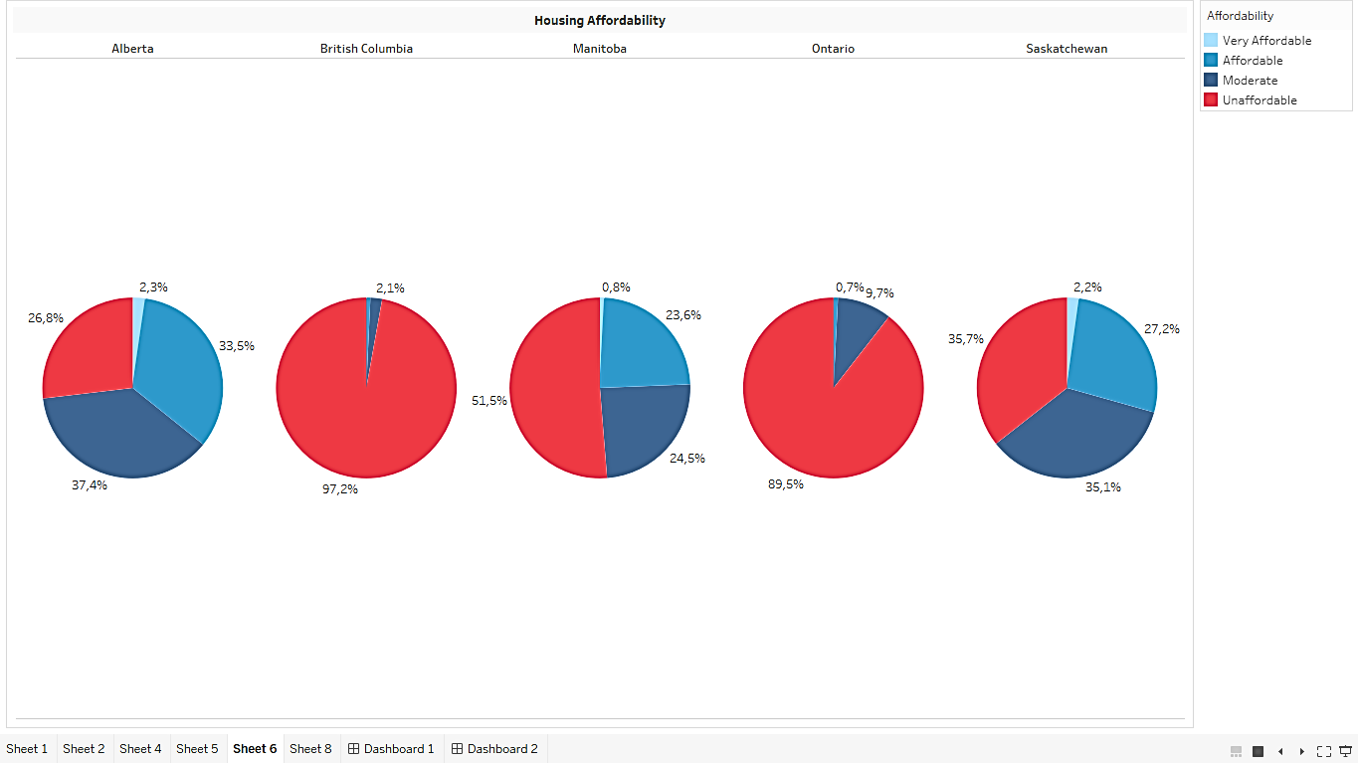
A Budget Story
The visualization depicting housing affordability ratios, further underscores the challenges they face.\. The Kowalski's must carefully weigh their options, balancing affordability with accessibility to essential services and support networks.

Slide 8

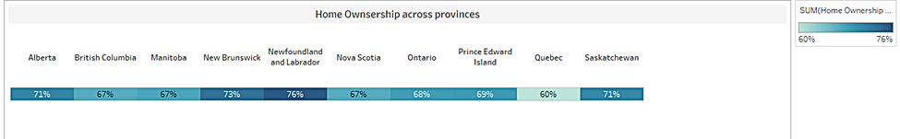
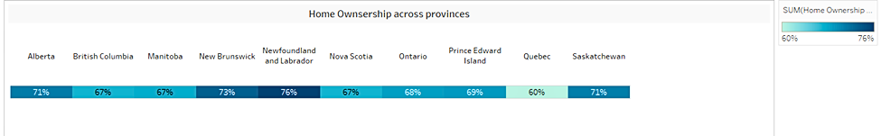

Hope is there
While the dream may look out of reach now, looking at home ownership across provinces The Kowalskis are optimistic about wokring hard and building a home of their own someday in Canada.

Slide 9
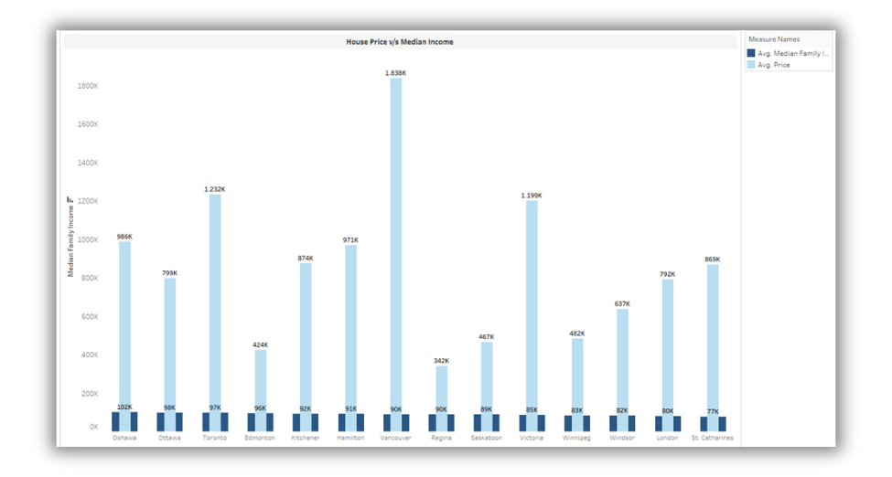
Reminder
The final visual serves as a stark reminder of the widening gap between housing prices and household income in Canada. This disparity represents a significant barrier to achieving long-term housing stability and financial security in Canada right now.

Slide 10


INSIGHTS
The Kowalski family's financial constraints and refugee background make finding affordable housing in Canada challenging, particularly in major cities.
01
Housing price differences across regions may require compromises, possibly distancing them from Ukrainian communities or restricting job options, along with other facilities
02
03
High housing-to-income ratios, indicative of the affordability crisis, may strain the family's limited resources, impeding their long-term housing stability.

Slide 11

CONCLUSION
The Kowalski family's journey to finding a new home in Canada is a microcosm of the broader housing affordability crisis faced by many newcomers and lower-income households. Their story serves as a poignant reminder of the challenges refugees and immigrants face in securing stable and affordable housing, a critical factor in their successful integration and long-term well-being.

Slide 12





CALL TO ACTION
To support families like the Kowalskis and address the housing affordability crisis, government must prioritize the following actions
Develop assistance programs and financial support schemes to help newcomers and refugees overcome the initial barriers to homeownership or securing stable rental housing.
Increase the supply of affordable housing units. particularly in well established regions for communities, to facilitate social and economic integration.
Foster collaboration s to create innovative and sustainable housing solutions tailored to the unique needs of various and all communities within canada
Promote inclusive urban planning and community development initiatives that prioritize affordable housing, access and essential services,

Slide 13
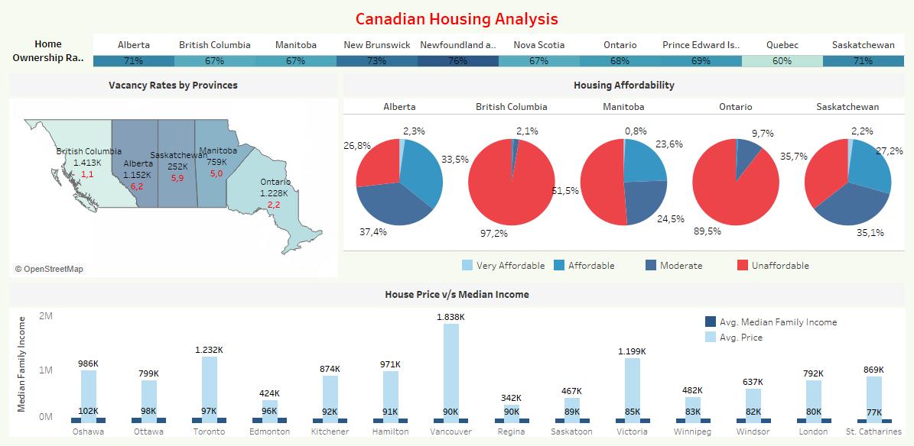

Slide 14
Thankyou

